Slide 1

Data Communication CSE 315
Dr. A.K.M. Muzahidul Islam
Professor
Computer Science & Engineering (CSE)
United International University (UIU)
Fall 2018

Slide 2
Schedule
Section ‘B’
Sat/Tuesday
11:40 a.m.~ 1:10 p.m.
Room No. 0332 (Level 3)
Counseling
14:00 p.m.~ 16:00 p.m.
Room No. 333/D (Level 3)
Section ‘C’
Sun/Wednesday
1:30 p.m.~ 3:00 p.m.
Room No. 0328 (Level 3)
Counseling
11:00 p.m.~ 13:00 p.m.
Room No. 333/D (Level 3)

Slide 3
Assessment
Attendance : 5%
Assignments : 5%
Class Tests : 20%
Mid Term : 30%
Final : 40%
Grading Policy
A (Plain) : 90-100 C+ (Plus) : 70-73
A- (Minus) : 86-89 C (Plain) : 66-69
B+ (Plus) : 82-85 C- (Minus) : 62-65
B (Plain) : 78-81 D+ (Plus) : 58-61
B- (Minus) : 74-77 D (Plain) : 55-57

Slide 4
Resources
Data Communications and Networking. Behrouz A. Forouzan
Data and Computer Communications. William Stallings (TENTH EDITION)
Modern Digitial and Analog Communication Systems. BP-Lathi Zhi Ding (4th edition)
Computer Networks Andrew S. Tanenbaum

Slide 5
Outline
Transmission Terminology
Guided Media
Unguided or Wireless Media
Summary

Slide 6
Transmission Terminology
Data transmission occurs between Transmitter Tx and Receiver Rx over some transmission medium:
Transmission Medium: Guided or Unguided.
In both cases, communication is in the form of electromagnetic waves.
Guided media
The waves are guided along a physical path.
Ex. Twisted pair, coaxial cable, and optical fiber.
Unguided media or Wireless media
Provides a means for transmitting electromagnetic waves but Do Not guide them;
Ex. propagation through air, vacuum, and seawater.
Notes:
Data transmission occurs between transmitter and receiver over some transmission
medium. Transmission media may be classified as guided or unguided. In both
cases, communication is in the form of electromagnetic waves. With guided media ,
the waves are guided along a physical path; examples of guided media are twisted
pair, coaxial cable, and optical fiber. Unguided media , also called wireless , provide
a means for transmitting electromagnetic waves but do not guide them; examples
are propagation through air, vacuum, and seawater.

Slide 7
Transmission Terminology
Direct Link (Direct Transmission path between Two Devices)
No intermediate devices used to increase signal strength (amplifiers/repeaters).
Point-to-Point (A Guided Transmission Medium)
Provides Direct link between two devices
Those are the only 2 devices sharing the medium
Multi-point
More than two devices share the same medium
Transmission may be Simplex, Half Duplex, or Full Duplex
Simplex
Signals are transmitted in only one direction i.e., One is Tx and the other Rx
Half-duplex
Both stations may transmit, but only one at a time
Full-duplex
Both stations may transmit simultaneously
The medium is carrying signals in both directions at the same time
Notes:
A transmission may be simplex, half duplex , or full duplex . In simplex transmission,
signals are transmitted in only one direction; one station is transmitter and
the other is receiver. In half-duplex operation, both stations may transmit, but only
one at a time. In full-duplex operation, both stations may transmit simultaneously.
In the latter case, the medium is carrying signals in both directions at the same time.
We should note that the definitions just given are the ones in common use in the
United States (ANSI definitions). Elsewhere (ITU-T definitions), the term simplex
is used to correspond to half duplex , and duplex is used to correspond to full duplex
as just defined.

Slide 8
Frequency, Spectrum, and Bandwidth
A Signal is transmitted by the Tx and transmitted over a medium
The Signal is a function of Time
The Signal can also be expressed as a function of Frequency
i.e., consists component of different frequencies
Frequency Domain view of a Signal is more important to an understanding of data transmission than a Time Domain.

Slide 9
Time Domain Concept
As a function of time, an electromagnetic signal can be either analog or digital.
Analog signal :
The signal intensity varies in a smooth, or continuous , fashion over time.
There are no breaks or discontinuities in the signal. Example: Speech
Digital signal :
The signal intensity maintains a constant level for some period of time and then abruptly changes to another constant level, in a discrete fashion.
Example: binary 1s and 0s.
Notes:
Viewed as a function of time, an electromagnetic signal
can be either analog or digital. An analog signal is one in which the signal intensity
varies in a smooth, or continuous , fashion over time. In other words, there are no
breaks or discontinuities in the signal. A digital signal is one in which the signal
intensity maintains a constant level for some period of time and then abruptly
changes to another constant level, in a discrete fashion. Figure 3.1 shows an example
of each kind of signal. The analog signal might represent speech, and the digital
signal might represent binary 1s and 0s.

Slide 10
Periodic Signal : The simplest sort of signal, in which the same signal pattern repeats over time.
Figure 3.2 shows an example of a periodic continuous signal (sine wave) and a periodic discrete signal (square wave).
Mathematically a signal s(t) is defined to be periodically, iff
s ( t + T ) = s (t) - ∞ < t < +∞
Notes:
The simplest sort of signal is a periodic signal , in which the same signal pattern
repeats over time. Figure 3.2 shows an example of a periodic continuous signal (sine
wave) and a periodic discrete signal (square wave).

Slide 11
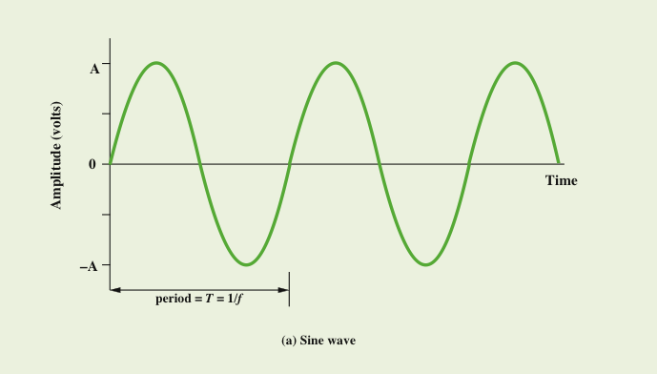
Sine Wave
Is the fundamental periodic signal
Can be represented by three parameters
s(t) = A sin(2πft + φ) Sinusoid
Peak amplitude (A)
Maximum value or strength of the signal over time
Typically measured in volts
Frequency (f)
Rate at which the signal repeats
Hertz (Hz) or cycles per second
Period (T) is the amount of time for one repetition; T = 1/f
Phase (φ)
Relative position in time within a single period of signal
Notes:
The sine wave is the fundamental periodic signal. A general sine wave can be
represented by three parameters: peak amplitude (A ), frequency (f ), and phase (φ ).
The peak amplitude is the maximum value or strength of the signal over time; typically,
this value is measured in volts. The frequency is the rate [in cycles per second,
or hertz (Hz)] at which the signal repeats. An equivalent parameter is the period
(T ) of a signal, which is the amount of time it takes for one repetition; therefore,
T = 1/f . Phase is a measure of the relative position in time within a single period of a
signal, as is illustrated subsequently.

Slide 12
The effect of varying A, f, φ
The frequency is 1 Hz; thus the period is T = 1 second.
Has the same frequency and phase but a peak amplitude of 0.5.
The effect of a phase shift of π/4 radians, which is 45 degrees (2π radians = 360˚ = 1 period).
We have f = 2, which is equivalent to T = 0.5.
Notes:
The general sine wave can be written
s(t) = A sin(2πft + f)
A function with the form of the preceding equation is known as a sinusoid. Figure 3.3 shows the effect of varying each of the three parameters. In part (a) of the figure, the frequency is 1 Hz; thus the period is T = 1 second. Part (b) has the same frequency and phase but a peak amplitude of 0.5. In part (c) we have f = 2, which is equivalent to T = 0.5. Finally, part (d) shows the effect of a phase shift of π/4 radians, which is 45 degrees (2π radians = 360˚ = 1 period).
InFigure 3.3, the horizontal axis is time; the graphs display the value of a signal at a given point in space as a function of time. These same graphs, with a change of scale, can apply with horizontal axes in space. In this case, the graphs display the value of a signal at a given point in time as a function of distance. For example, for a sinusoidal transmission (e.g., an electromagnetic radio wave some distance from a radio antenna, or sound some distance from a loudspeaker), at a particular instant of time, the intensity of the signal varies in a sinusoidal way as a function of distance from the source.

Slide 13
Wavelength (λ)
The wavelength of a signal is the distance occupied by a single cycle
Can also be stated as the distance between two points of corresponding phase of two consecutive cycles
Assuming signal velocity v, then the wavelength is related to the period as
λ = vT
Or equivalently λ = c/f ; T = 1/f
Especially when v=c
c = 3*10⁸ m/s (speed of light in free space)
λ = cT
There is a simple relationship between the two sine waves, one in time and one in space.
Notes:
There is a simple relationship between the two sine waves, one in time and one in space. The wavelength (λ) of a signal is the distance occupied by a single cycle, or, put another way, the distance between two points of corresponding phase of two consecutive cycles. Assume that the signal is traveling with a velocity v. Then the wavelength is related to the period as follows: l = vT. Equivalently, lf = v. Of particular relevance to this discussion is the case where v = c, the speed of light in free space, which is approximately 3 ´ 10⁸ m/s.

Slide 14


Slide 15
Spectrum and Bandwidth
Spectrum
Range of frequencies contained in signal
Absolute bandwidth
Width of spectrum
Effective bandwidth (or just bandwidth)
Most of the energy in the signal is contained in a relatively narrow band of frequencies. This band is referred to as the effective bandwidth, or just bandwidth.
Set of Frequencies e.g., f, 3f, etc.
Figure 3.4c, the bandwidth is 3f – f = 2f.
Many signals, such as that of Figure 3.5b, have an infinite bandwidth.
Notes:
The spectrum of a signal is the range of frequencies that it contains. For the signal of Figure 3.4c, the spectrum extends from f to 3f. The absolute bandwidth of a signal is the width of the spectrum. In the case of Figure 3.4c, the bandwidth is 3f – f = 2f. Many signals, such as that of Figure 3.5b, have an infinite bandwidth. However, most of the energy in the signal is contained in a relatively narrow band of frequencies. This band is referred to as the effective bandwidth, or just bandwidth.
One final term to define is dc component. If a signal includes a component of zero frequency, that component is a direct current (dc) or constant component.

Slide 16
Data Rate and Bandwidth
Effective bandwidth is the band within which most of the signal energy is concentrated.
Any transmission system (transmitter + medium + receiver) will be able to accommodate only a limited band of frequencies i.e., limits the data rate that can be carried on the transmission medium.
Any transmission system has a limited band of frequencies
This limits the data rate that can be carried on the transmission medium
Square waves have infinite components and hence an infinite bandwidth
Most energy in first few components
Limiting bandwidth creates distortions
There is a direct relationship between
data rate and bandwidth
Notes:
We have said that effective bandwidth is the band within which most of the signal energy is concentrated. The meaning of the term most in this context is somewhat arbitrary. The important issue here is that, although a given waveform may contain frequencies over a very broad range, as a practical matter any transmission system (transmitter plus medium plus receiver) will be able to accommodate only a limited band of frequencies. This, in turn, limits the data rate that can be carried on the transmission medium.
To try to explain these relationships, consider the square wave of Figure 3.2b. Suppose that we let a positive pulse represent binary 0 and a negative pulse represent binary 1. Then the waveform represents the binary stream 0101…. The duration of each pulse is 1/(2f); thus the data rate is 2f bits per second (bps). What are the frequency components of this signal? To answer this question, consider againFigure 3.4. By adding together sine waves at frequencies f and 3f, we get a waveform that begins to resemble the original square wave.

Slide 17
Summary
Advantages:
Increased bandwidth -> increased accuracy
Increased frequency -> increased data rate
Disadvantages:
Increased bandwidth -> increased cost
Increased frequency -> increased complexity (cost)
A designer chooses a signal that maximizes data rate, minimizes errors and minimizes cost.

Slide 18
Frequency Domain Concept

Slide 19
Earlier observed, analog signals,
used to represent analog data, and digital signals, used to represent digital data.
Digital data can also be represented by analog signals by use of a modem (modulator/demodulator).
The modem converts a series of binary (two-valued) voltage pulses into an analog signal by encoding the digital data onto a carrier frequency.
Analog data can be represented by digital signals. The device that performs this function for voice data is a codec (coder-decoder).
Notes:
In the foregoing discussion, we have looked at analog signals,
used to represent analog data, and digital signals, used to represent digital
data. Generally, analog data are a function of time and occupy a limited frequency
spectrum; such data can be represented by an electromagnetic signal occupying the
same spectrum. Digital data can be represented by digital signals, with a different
voltage level for each of the two binary digits.
As Figure 3.13 illustrates, these are not the only possibilities. Digital data can
also be represented by analog signals by use of a modem (modulator/demodulator).
The modem converts a series of binary (two-valued) voltage pulses into an
analog signal by encoding the digital data onto a carrier frequency. The resulting
signal occupies a certain spectrum of frequency centered about the carrier and
may be propagated across a medium suitable for that carrier. The most common
modems represent digital data in the voice spectrum and hence allow those data to
be propagated over ordinary voice-grade telephone lines. At the other end of the
line, another modem demodulates the signal to recover the original data.
In an operation very similar to that performed by a modem, analog data can
be represented by digital signals. The device that performs this function for voice
data is a codec (coder-decoder). In essence, the codec takes an analog signal that
directly represents the voice data and approximates that signal by a bit stream. At
the receiving end, the bit stream is used to reconstruct the analog data.
Thus, Figure 3.13 suggests that data may be encoded into signals in a variety of
ways. We return to this topic in Chapter 5.

Slide 20
Transmission Impairments
Signal received may differ from signal transmitted causing:
Analog - degradation of signal quality
Digital - bit errors
Most significant impairments are
Attenuation and attenuation distortion
Signal strength falls off with distance over any transmission medium
Delay distortion
Occurs in transmission cables such as twisted pair, coaxial cable, and optical fiber
Does not occur when signals are transmitted through the air by means of antennas
Noise
Unwanted signals inserted between transmitter and receiver
Notes:
With any communications system, the signal that is received may differ from the
signal that is transmitted, due to various transmission impairments. For analog signals,
these impairments introduce various random modifications that degrade the
signal quality. For digital signals, bit errors may be introduced, such that a binary 1
is transformed into a binary 0 or vice versa. In this section, we examine the various
impairments and how they may affect the information-carrying capacity of a communication
link; Chapter 5 looks at measures that can be taken to compensate for
these impairments.
The most significant impairments are
• Attenuation and attenuation distortion
• Delay distortion
• Noise

Slide 22
Nyquist Bandwidth
In the case of a channel that is noise free:
The limitation of data rate is simply the bandwidth of the signal
If the rate of signal transmission is 2B then a signal with frequencies no greater than B is sufficient to carry the signal rate
Given a bandwidth of B, the highest signal rate that can be carried is 2B
For binary signals, the data rate that can be supported by B Hz is 2B bps
With multilevel signaling, the Nyquist formula becomes: C = 2B log₂M
Data rate can be increased by increasing the number of different signal elements
This increases burden on receiver
Noise and other impairments limit the practical value of M
Notes:
To begin, let us consider the case of a channel that is noise free. In this environment, the limitation on data rate is simply the bandwidth of the signal. A formulation of this limitation, due to Nyquist, states that if the rate of signal transmission is 2B, then a signal with frequencies no greater than B is sufficient to carry the signal rate. The converse is also true: Given a bandwidth of B, the highest signal rate that can be carried is 2B. This limitation is due to the effect of intersymbol interference, such as is produced by delay distortion. The result is useful in the development of digital-to-analog encoding schemes and is, in essence, based on the same derivation as that of the sampling theorem, described in Appendix G.
Note that in the preceding paragraph, we referred to signal rate. If the signals to be transmitted are binary (two voltage levels), then the data rate that can be supported by B Hz is 2B bps. However, as we shall see in Chapter 5, signals with more than two levels can be used; that is, each signal element can represent more than one bit. For example, if four possible voltage levels are used as signals, then each signal element can represent two bits. With multilevel signaling, the Nyquist formulation becomes
C = 2B log₂M
where M is the number of discrete signal or voltage levels.
So, for a given bandwidth, the data rate can be increased by increasing the number of different signal elements. However, this places an increased burden on the receiver: Instead of distinguishing one of two possible signal elements during each signal time, it must distinguish one of M possible signal elements. Noise and other impairments on the transmission line will limit the practical value of M.

Slide 23
Shannon Capacity Formula
Considering the relation of data rate, noise and error rate:
Faster data rate shortens each bit so bursts of noise corrupts more bits
Given noise level, higher rates mean higher errors
Shannon developed formula relating these to signal to noise ratio (in decibels)
SNR_{db}⁼10 log₁₀ (signal/noise)
Capacity C = B log₂(1+SNR)
Theoretical maximumcapacity
Get much lower rates in practice
Notes:
Nyquist's formula indicates that, all other things being equal, doubling the bandwidth doubles the data rate. Now consider the relationship among data rate, noise, and error rate. The presence of noise can corrupt one or more bits. If the data rate is increased, then the bits become "shorter" so that more bits are affected by a given pattern of noise.
Figure 3.15 illustrates this relationship. If the data rate is increased, then more bits will occur during the interval of a noise spike, and hence more errors will occur.
All of these concepts can be tied together neatly in a formula developed by the mathematician Claude Shannon. As we have just illustrated, the higher the data rate, the more damage that unwanted noise can do. For a given level of noise, we would expect that a greater signal strength would improve the ability to receive data correctly in the presence of noise. The key parameter involved in this reasoning is the signal-to-noise ratio (SNR, or S/N), which is the ratio of the power in a signal to the power contained in the noise that is present at a particular point in the transmission. Typically, this ratio is measured at a receiver, because it is at this point that an attempt is made to process the signal and recover the data. For convenience, this ratio is often reported in decibels:
The signal-to-noise ratio is important in the transmission of digital data because it sets the upper bound on the achievable data rate. Shannon's result is that the maximum channel capacity, in bits per second, obeys the equation
C = B log2 (1 + SNR) (3.1)
where C is the capacity of the channel in bits per second and B is the bandwidth of the channel in hertz. The Shannon formula represents the theoretical maximum that can be achieved. In practice, however, only much lower rates are achieved. One reason for this is that the formula assumes white noise (thermal noise). Impulse noise is not accounted for, nor are attenuation distortion or delay distortion. Even in an ideal white noise environment, present technology still cannot achieve Shannon capacity due to encoding issues, such as coding length and complexity.
The capacity indicated in the preceding equation is referred to as the error-free capacity. Shannon proved that if the actual information rate on a channel is less than the error-free capacity, then it is theoretically possible to use a suitable signal code to achieve error-free transmission through the channel. Shannon's theorem unfortunately does not suggest a means for finding such codes, but it does provide a yardstick by which the performance of practical communication schemes may be measured.
Several other observations concerning the preceding equation may be instructive. For a given level of noise, it would appear that the data rate could be increased by increasing either signal strength or bandwidth. However, as the signal strength increases, so do the effects of nonlinearities in the system, leading to an increase in intermodulation noise. Note also that, because noise is assumed to be white, the wider the bandwidth, the more noise is admitted to the system. Thus, as B increases, SNR decreases.
The Expression Eb/N0
Finally, we mention a parameter related to SNR that is more convenient for determining digital data rates and error rates and that is the standard quality measure for digital communication system performance. The parameter is the ratio of signal energy per bit to noise power density per hertz, Eb/N0. Consider a signal, digital or analog, that contains binary digital data transmitted at a certain bit rate R. Recalling that 1 watt = 1 J/s, the energy per bit in a signal is given by Eb = STb, where S is the signal power and Tb is the time required to send one bit. The data rate R is just R = 1/Tb.
The ratio Eb/N0 is important because the bit error rate for digital data is a (decreasing) function of this ratio. Given a value of Eb/N0 needed to achieve a desired error rate, the parameters in the preceding formula may be selected. Note that as the bit rate R increases, the transmitted signal power, relative to noise, must increase to maintain the required Eb/N0.
Let us try to grasp this result intuitively by considering again Figure 3.15. The signal here is digital, but the reasoning would be the same for an analog signal. In several instances, the noise is sufficient to alter the value of a bit. If the data rate were doubled, the bits would be more tightly packed together, and the same passage of noise might destroy two bits. Thus, for constant signal to noise ratio, an increase in data rate increases the error rate.
The advantage of Eb/N0 over SNR is that the latter quantity depends on the bandwidth.

Slide 25
Design Factors Determining Data Rate and Distance
Data rate and distance are the key considerations in data transmission system design;
Bandwidth
Higher bandwidth gives higher data rate
Transmission impairments
Impairments, such as attenuation, limit the distance
Interference
Overlapping frequency bands can distort or wipe out a signal
Number of receivers
More receivers introduces more attenuation
Notes:
Data rate and distance are the key considerations in data transmission system design; with emphasis placed on achieving the highest data rates over the longest distances. A number of design factors relating to the transmission medium and the signal determine the data rate and distance:
Bandwidth: All other factors remaining constant, the greater the bandwidth of a signal, the higher the data rate that can be achieved.
Transmission impairments: Impairments, such as attenuation, limit the distance. For guided media, twisted pair generally suffers more impairment than coaxial cable, which in turn suffers more than optical fiber.
Interference: Interference from competing signals in overlapping frequency bands can distort or cancels out a signal. Interference is of particular concern for unguided media, but is also a problem with guided media. For guided media, interference can be caused by emanations coupling from nearby cables (alien crosstalk) or adjacent conductors under the same cable sheath (internal crosstalk). For example, twisted pairs are often bundled together and conduits often carry multiple cables. Interference can also be caused by electromagnetic coupling from unguided transmissions. Proper shielding of a guided medium can minimize this problem.
Number of receivers: A guided medium can be used to construct a point-to-point link or a shared link with multiple attachments. In the latter case, each attachment introduces some attenuation and distortion on the line, limiting distance and/or data rate.

Slide 26
Electromagnetic Spectrum
For Telecommunications
Figure 4.1 depicts the electromagnetic spectrum and indicates the frequencies
at which various guided media and unguided transmission techniques operate.
Notes:
Figure 4.1 depicts the electromagnetic spectrum and indicates the frequencies
at which various guided media and unguided transmission techniques operate.
In this chapter, we examine these guided and unguided alternatives. In all cases,
we describe the systems physically, briefly discuss applications, and summarize key
transmission characteristics.

Slide 27
The three guided media commonly used for data transmission:
(1) Twisted pair,
(2) Coaxial cable
(3) Optical fiber
Notes:
The three guided media commonly used for data transmission are twisted pair,
coaxial cable, and optical fiber (Figure 4.2). We examine each of these in turn.

Slide 28
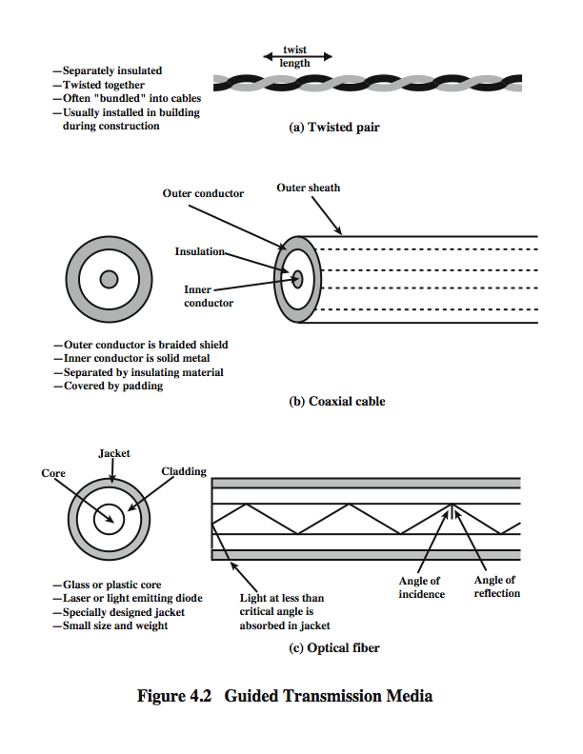
Twisted Pair
Twisted pair is the least expensive and most widely used guided transmission medium
Consists of two insulated copper wires arranged in a regular spiral pattern
A wire pair acts as a single communication link
Pairs are bundled together into a cable
Most commonly used in the telephone network and for communications within buildings
Notes:
The least expensive and most widely used guided transmission medium is twisted pair.
A twisted pair consists of two insulated copper wires arranged in a regular spiral pattern. A wire pair acts as a single communication link. Typically, a number of these pairs are bundled together into a cable by wrapping them in a tough protective sheath, or jacket. Over longer distances, cables may contain hundreds of pairs. The twisting tends to decrease the crosstalk interference between adjacent pairs in a cable. Neighboring pairs in a bundle typically have somewhat different twist lengths to reduce the crosstalk interference. On long-distance links, the twist length typically varies from 5 to 15 cm. The wires in a pair have thicknesses of from 0.4 to 0.9 mm.
By far the most common guided transmission medium for both analog and digital signals is twisted pair. It is the most commonly used medium in the telephone network and is the workhorse for communications within buildings.
In the telephone system, individual residential telephone sets are connected to the local telephone exchange, or "end office," by twisted-pair wire. These are referred to as subscriber loops. Within an office building, each telephone is also connected to a twisted pair, which goes to the in-house private branch exchange (PBX) system or to a Centrex facility at the end office. These twisted-pair installations were designed to support voice traffic using analog signaling. However, by means of a modem, these facilities can handle digital data traffic at modest data rates.
Twisted pair is also the most common medium used for digital signaling. For connections to a digital data switch or digital PBX within a building, a data rate of 64 kbps is common. Ethernet operating over twisted-pair cabling is commonly used within a building for local area networks supporting personal computers. Data rates for Ethernet products are typically in the neighborhood of 100 Mbps to 1 Gbps. Emerging twisted-pair cabling Ethernet technology can support data rates of 10Gbps. For long-distance applications, twisted pair can be used at data rates of 4 Mbps or more.
Twisted pair is much less expensive than the other commonly used guided transmission media (coaxial cable, optical fiber) and is easier to work with.

Slide 29
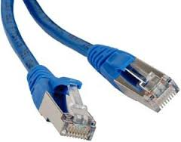
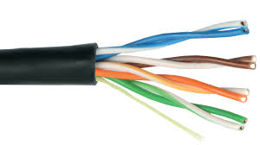
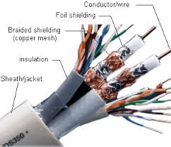
Unshielded and Shielded Twisted Pair
Unshielded Twisted Pair (UTP)
Subject to external electromagnetic interference
Shielded Twisted Pair (STP)
Has metal braid or sheathing that reduces interference
Provides better performance at higher data rates
More expensive
Ordinary telephone wire
Consists of one or more twisted-pair cables, typically enclosed within an overall thermoplastic jacket which provides no electromagnetic shielding
The tighter the twisting, the higher the supported transmission rate and the greater the cost per meter
Notes:
Twisted pair comes in two varieties: unshielded and shielded. As the name implies, unshielded twisted pair (UTP) consists of one or more twisted-pair cables, typically enclosed within an overall thermoplastic jacket, which provides no electromagnetic shielding. The most common form of UTP is ordinary voice-grade telephone wire, which is pre-wired in residential and office buildings. For data transmission purposes, UTP may vary from voice-grade to very high-speed cable for local area networks (LANs). For high-speed LANs, UTP typically has four pairs of wires inside the jacket, with each pair twisted with a different number of twists per centimeter to help eliminate interference between adjacent pairs. The tighter the twisting, the higher the supported transmission rate and the greater the cost per meter.
Unshielded twisted pair is subject to external electromagnetic interference, including interference from nearby twisted pair and from noise generated in the environment. In an environment with a number of sources of potential interference (e.g., electric motors, wireless devices, and RF transmitters), shielded twisted pair (STP) may be a preferred solution. Shielded twisted pair cable is manufactured in three different configurations:
Each pair of wires is individually shielded with metallic foil, generally referred to as foil twisted pair (FTP).
2. There is a foil or braid shield inside the jacket covering all wires (as a group). This configuration is sometimes designated as screened twisted pair (F/UTP).
3.There is a shield around each individual pair, as well as around the entire group of wires. This is referred to as fully-shielded twisted pair or shielded/foil twisted pair (S/FTP).
The shielding reduces interference and provides better performance at higher data rates. However, it may be more expensive and installers familiar with UTP technology may be reluctant to work with a new media type.

Slide 30
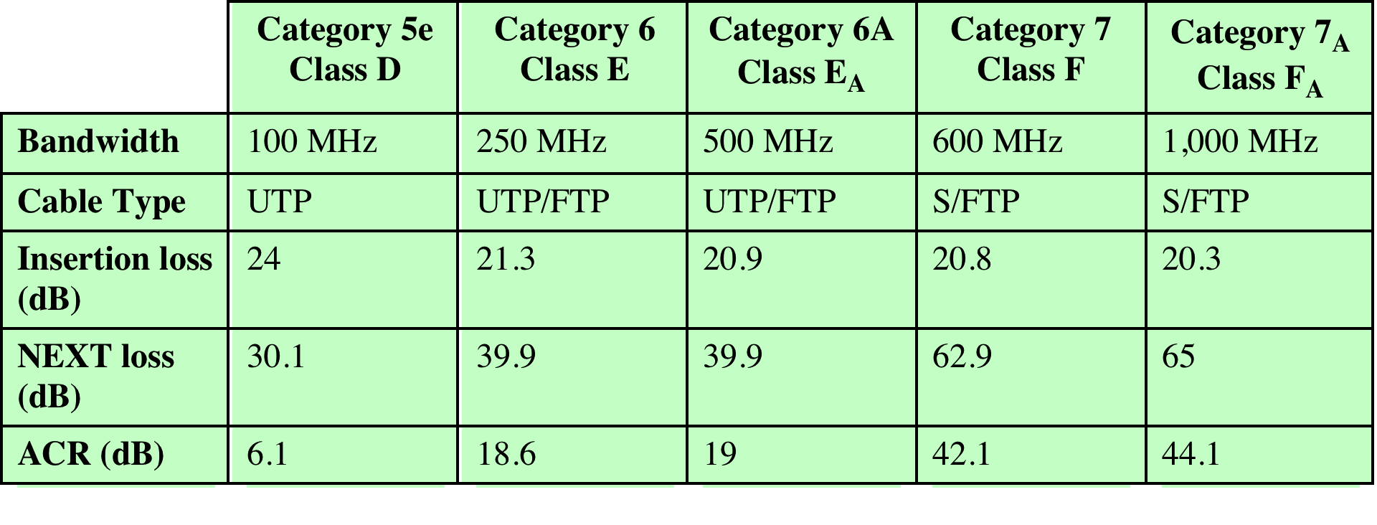
Table 4.2
Twisted Pair Categories and Classes
UTP = Unshielded twisted pair
FTP = Foil twisted pair
S/FTP = Shielded/foil twisted pair
Notes:
In 1991, the Electronic Industries Association published standard ANSI/EIA/TIA-568, Commercial Building Telecommunications Cabling Standard, which specifies the use of voice- and data-grade UTP and F/UTP cabling for in-building data applications. At that time, the specification was felt to be adequate for the range of frequencies and data rates found in office environments. With continuing advances in cable and connector design and test methods, this standard has undergone a number of iterations to provide support for higher data rates using higher-quality cable and connectors. The current version is the responsibility of the Telecommunications Industry Association, and was issued in 2009 as four American National Standards Institute (ANSI) standards:
ANSI/TIA-568-C.0 Generic Telecommunications Cabling for Customer Premises: Enables the planning and installation of a structured cabling system for all types of customer premises.
ANSI/TIA-568-C.1 Commercial Building Telecommunications Cabling Standard: Enables the planning and installation of a structured cabling system for commercial buildings.
ANSI/TIA-568-C.2 Balanced Twisted-Pair Telecommunications Cabling and Components Standards: Specifies minimum requirements for balanced twisted-pair telecommunications cabling (e.g. channels and permanent links) and components (e.g. cable, connectors, connecting hardware, patch cords, equipment cords, work area cords, and jumpers) that are used up to and including the telecommunications outlet/connector and between buildings in a campus environment. This Standard also specifies field test procedures and applicable laboratory reference measurement procedures for all transmission parameters.
ANSI/TIA-568-C.3 Optical Fiber Cabling Components Standard: Specifies cable and component transmission performance requirements for premises optical fiber cabling.
The 568-C standards identify a number of categories of cabling and associated components that can be used for premises and campus-wide data distribution. An overlapping standard, jointly issued by the International Standards Organization and the International Electrotechnical Commission (IEC), known as ISO/IEC 11801, second edition, identifies a number of classes of cabling and associated components, which correspond to the 568-C categories.
The categories listed in the table are the following:
Category 5e/Class D: This specification was first published in 2000 in order to address the transmission performance characterization required by applications such as 1-Gbps Ethernet that utilize bi-directional and full four-pair transmission schemes (described in Chapter 12).
Category 6/Class E: In recent years, the majority of structured cabling specified for new buildings has been category 6/class E. This category provides a greater performance margin (also called performance headroom) than category 5e to ensure that the cabling plant could withstand the rigors of the cabling environment and still support 1-Gbps Ethernet when it was time for an application upgrade from 100-Mbps Ethernet. This category was published in 2002, with a targeted lifetime of 10 years, so its use is likely to decline rapidly in new installations.
Category 6A/Class E_{A}: This specification is targeted at 10-Gbps Ethernet applications.
Category 7/Class F: This specification uses fully-shielded twisted pair (i.e., cabling with an overall shield and individually shielded pairs). The advantage of this category over lower grades of cabling is that the use of both an overall shield and a foil shield around individual pairs dramatically decreases internal pair-to-pair crosstalk and external alien crosstalk. This class is targeted for support of next generation applications beyond 10-Gbps Ethernet.
Category 7A/Class F_{A}: The requirements for this class are based on class F cabling requirements. The main enhancement is to extend the frequency bandwidth to 1 GHz. This enhancement enables support of all channels of broadband video (e.g. CATV) that operate up to 862 MHz. It is likely that all fully-shielded cabling solutions specified in the near future will be class F_{A}.
Table 4.2 includes three key performance parameters. Insertion loss in this
context refers to the amount of attenuation across the link from the transmitting
system to the receiving system. Thus, lower dB values are better. The table shows
the amount of attenuation at a frequency of 100 MHz. This is the standard frequency
used in tables comparing various classes of twisted pair. However, attenuation is
an increasing function of frequency, and the 568 standards specify the attenuation
at various frequencies. In accordance with ANSI/TIA-568-C.2 and ISO/IEC 11801
second edition, all transmission characteristics are specified as a worst-case value
for a 100 m length. While cabling lengths may be less than 100 m, no provisions are
provided in the standards for the scaling of the specified limits. Attenuation in decibels
is a linear function of distance, so attenuation for shorter or longer distances
is easily calculated. In practice, as is shown in Chapter 12, distances much less than
100 m are typical for Ethernet at data rates of 1 GB and above.

Slide 31
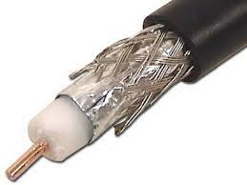
Coaxial Cable
Coaxial cable can be used over longer distances and support more stations on a shared line than twisted pair
Consists of a hollow outer cylindrical conductor that surrounds a single inner wire conductor
Is a versatile transmission medium used in a wide variety of applications e.g., TV distribution, long distance telephone transmission and LANs
Notes:
Coaxial cable, like twisted pair, consists of two conductors, but is constructed differently to permit it to operate over a wider range of frequencies. It consists of a hollow outer cylindrical conductor that surrounds a single inner wire conductor (Figure 4.2b). The inner conductor is held in place by either regularly spaced insulating rings or a solid dielectric material. The outer conductor is covered with a jacket or shield. A single coaxial cable has a diameter of from 1 to 2.5 cm. Coaxial cable can be used over longer distances and support more stations on a shared line than twisted pair.
Coaxial cable is a versatile transmission medium, used in a wide variety of applications. The most important of these are
Television distribution
Long-distance telephone transmission
Short-run computer system links
Local area networks
Coaxial cable is widely used as a means of distributing TV signals to individual homes—cable TV. From its modest beginnings as Community Antenna Television (CATV), designed to provide service to remote areas, cable TV reaches almost as many homes and offices as the telephone. A cable TV system can carry dozens or even hundreds of TV channels at ranges up to a few tens of kilometers.
Coaxial cable has traditionally been an important part of the long-distance telephone network. Today, it faces increasing competition from optical fiber, terrestrial microwave, and satellite. Using frequency division multiplexing (FDM, see Chapter 8), a coaxial cable can carry over 10,000 voice channels simultaneously.
Coaxial cable is also commonly used for short-range connections between devices. Using digital signaling, coaxial cable can be used to provide high-speed I/O channels on computer systems.

Slide 32
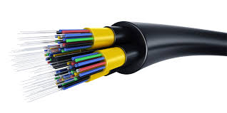
Optical Fiber
A Thin flexible medium capable of guiding an optical ray
Various glasses and plastics can be used to make optical fibers
Has a cylindrical shape with three sections
core (8-62.5 μm) – innermost, consists of thin strands made of glass or plastic
cladding (125 μm) – glass or plastic coating that surrounds the core to confine light.
Jacket – Hard plastic coating that protects the glass from moisture and damage
Widely used in long distance telecommunications
Performance, price and advantages have made it popular to use
Notes:
An optical fiber is a thin, flexible medium capable of
guiding an optical ray. Various glasses and plastics can be used to make optical
fibers. The lowest losses have been obtained using fibers of ultrapure fused silica.
Ultrapure fiber is difficult to manufacture; higher-loss multicomponent glass fibers
are more economical and still provide good performance. Plastic fiber is even less
costly and can be used for short-haul links, for which moderately high losses are
acceptable.
An optical fiber strand (also called an optical waveguide ) has a cylindrical
shape and consists of three concentric sections: the core, the cladding, and the
buffer coating (Figure 4.2c). The core is the innermost section and consists of
thin strands made of glass or plastic; the core has a diameter in the range of 8 to
62.5 μm. The core is surrounded by a cladding , which is a glass or plastic coating
that has optical properties different from those of the core and a diameter of
125 μm. The interface between the core and cladding acts as a reflector to confine
light that would otherwise escape the core. The outermost layer is the buffer
coating , which is a hard plastic coating that protects the glass from moisture and
physical damage.
Fiber optic cable provides protection to the fiber from stress during installation
and from the environment once it is installed. Cables may contain from only
one to hundreds of fibers inside. The outermost layer of the cable, surrounding one
or a bundle of fibers, is the jacket . The jacket is composed of plastic and other
materials, layered to protect against moisture, abrasion, crushing, and other environmental
dangers.
Optical fiber already enjoys considerable use in long-distance
telecommunications, and its use in military applications is growing. The continuing
improvements in performance and decline in prices, together with the inherent
advantages of optical fiber, have made it increasingly attractive for local area
networking.

Slide 33
Optical Fiber - Benefits
Greater capacity
Data rates of hundreds of Gbps over tens of kilometers
Smaller size and lighter weight
Considerably thinner than coaxial or twisted pair cable
Reduces structural support requirements
Lower attenuation
Electromagnetic isolation
Not vulnerable to interference, impulse noise, or crosstalk
High degree of security from eavesdropping
Greater repeater spacing
Lower cost and fewer sources of error
Notes:
The following characteristics distinguish optical fiber from twisted pair
or coaxial cable:
• Greater capacity: The potential bandwidth, and hence data rate, of optical
fiber is immense; data rates of hundreds of Gbps over tens of kilometers have
been demonstrated. Compare this to the practical maximum of hundreds of
Mbps over about 1 km for coaxial cable and just a few Mbps over 1 km or up
to 100 Mbps to 10 Gbps over a few tens of meters for twisted pair.
• Smaller size and lighter weight: Optical fibers are considerably thinner than
coaxial cable or bundled twisted-pair cable—at least an order of magnitude
thinner for comparable information transmission capacity. For cramped conduits
in buildings and underground along public rights-of-way, the advantage
of small size is considerable. The corresponding reduction in weight reduces
structural support requirements.
• Lower attenuation: Attenuation is significantly lower for optical fiber than for
coaxial cable or twisted pair (Figure 4.3c) and is constant over a wide range.
• Electromagnetic isolation: Optical fiber systems are not affected by external
electromagnetic fields. Thus the system is not vulnerable to interference,
impulse noise, or crosstalk. By the same token, fibers do not radiate energy, so
there is little interference with other equipment and there is a high degree of
security from eavesdropping. In addition, fiber is inherently difficult to tap.
• Greater repeater spacing: Fewer repeaters mean lower cost and fewer sources
of error. The performance of optical fiber systems from this point of view has
been steadily improving. Repeater spacing in the tens of kilometers for optical
fiber is common, and repeater spacings of hundreds of kilometers have
been demonstrated. Coaxial and twisted-pair systems generally have repeaters
every few kilometers.

Slide 34
Categories of Application
Five basic categories of application have become important for optical fiber:
Long-haul trunks (i.e. long-distance link)
Connects all central switches and long-distance switches
Average 1500 km and 20k to 60k voice channels
Metropolitan trunks
Average 12 km and 100k voice channels
Rural exchange trunks
Links towns and villages 40km to 160 km and 5k voice channels
Subscriber loops
Link between central exchange to a subscriber i.e. home, office, etc.
Local area networks
100 Gbps and 1000s of stations are supported.
Notes:
Five basic categories of application have become important for optical fiber:
• Long-haul trunks
• Metropolitan trunks
• Rural exchange trunks
• Subscriber loops
• Local area networks
Telephone networks were the first major users of fiber optics. Fiber optic links
were used to replace copper or digital radio links between telephone switches, beginning
with long-distance links, called long lines or long haul, where fiber’s distance
and bandwidth capabilities made fiber significantly more cost-effective. Optical
fiber is used to connect all central offices and long-distance switches because it has
thousands of times the bandwidth of copper wire and can carry signals hundreds
of times further before needing a repeater, making the cost of a phone connection
over fiber only a few percent of the cost of the same connection on copper.
Long-haul routes average about 1500 km in length and offer high capacity (typically
20,000 to 60,000 voice channels). Undersea optical fiber cables have also enjoyed
increasing use.
Metropolitan trunking circuits have an average length of 12 km and may have
as many as 100,000 voice channels in a trunk group. Most facilities are installed in
underground conduits and are repeaterless, joining telephone exchanges in a metropolitan
or city area. Included in this category are routes that link long-haul microwave
facilities that terminate at a city perimeter to the main telephone exchange
building downtown.
Rural exchange trunks have circuit lengths ranging from 40 to 160 km that
link towns and villages. In the United States, they often connect the exchanges of
different telephone companies. Most of these systems have fewer than 5000 voice
channels. With the exception of some rugged or remote locations, the entire telephone
backbone is now optical fiber. Cables on the land are run underground or
aerially, depending on the geography and local regulations. Connections around
the world are run primarily on undersea cables, which now link every continent and
most island nations with the exception of Antarctica.
Subscriber loop circuits are fibers that run directly from the central exchange
to a subscriber. These facilities are beginning to displace twisted pair and coaxial
cable links as the telephone networks evolve into full-service networks capable of
handling not only voice and data, but also image and video. The initial penetration
of optical fiber in this application has been for the business subscriber, but fiber
transmission into the home is now a significant presence in many areas.
A final important application of optical fiber is for local area networks.
Standards have been developed and products introduced for optical fiber networks
that have a total capacity of up to 100 Gbps and can support thousands of stations in
a large office building or a complex of buildings.

Slide 35
Single-mode Transmission - a single transmission path exists, the distortion found in multimode cannot occur; faster
Multimode transmission - multiple propagation paths exist,
each with a different path length; slower.
Light from a source enters the cylindrical glass or plastic core.
Rays at shallow angles are reflected and propagated along the fiber; other rays are absorbed by the surrounding material.
Notes:
Figure 4.7 shows the principle of optical fiber transmission. Light from a source
enters the cylindrical glass or plastic core. Rays at shallow angles are reflected and
propagated along the fiber; other rays are absorbed by the surrounding material.
This form of propagation is called step-index multimode , referring to the variety of
angles that reflect. With multimode transmission, multiple propagation paths exist,
each with a different path length and hence time to traverse the fiber. This causes
signal elements (light pulses) to spread out in time, which limits the rate at which
data can be accurately received. Put another way, the need to leave spacing between
the pulses limits data rate. This type of fiber is best suited for transmission over very
short distances. When the fiber core radius is reduced, fewer angles will reflect. By
reducing the radius of the core to the order of a wavelength , only a single angle or
mode can pass: the axial ray. This single-mode propagation provides superior performance
for the following reason. Because there is a single transmission path with
single-mode transmission, the distortion found in multimode cannot occur. Single
mode is typically used for long-distance applications, including telephone and cable
television. Finally, by varying the index of refraction of the core, a third type of
transmission, known as graded-index multimode , is possible. This type is intermediate
between the other two in characteristics. The higher refractive index (discussed
subsequently) at the center makes the light rays moving down the axis advance
more slowly than those near the cladding. Rather than zig-zagging off the cladding,
light in the core curves helically because of the graded index, reducing its travel distance.
The shortened path and higher speed allows light at the periphery to arrive at
a receiver at about the same time as the straight rays in the core axis. Graded-index
fibers are often used in LANs.

Slide 37
Wireless Transmission Frequencies
Three general ranges of frequencies are of interest for wireless transmission.
1GHz to 40GHz
Referred to as microwave frequencies
Highly directional beams are possible
Suitable for point to point transmissions
Also used for satellite communications
30MHz to 1GHz
Suitable for omnidirectional applications
Referred to as the radio range
3 x 10¹¹ to 2 x 10¹⁴
Infrared portion of the spectrum
Useful to local point-to-point and multipoint applications within confined areas
Notes:
Three general ranges of frequencies are of interest in our discussion of wireless transmission. Frequencies in the range of about 1 GHz (gigahertz = 10⁹ hertz) to 40 GHz are referred to as microwave frequencies. At these frequencies, highly directional beams are possible, and microwave is quite suitable for point-to-point transmission. Microwave is also used for satellite communications. Frequencies in the range of 30 MHz to 1 GHz are suitable for omnidirectional applications. We refer to this range as the radio range.
Another important frequency range, for local applications, is the infrared portion of the spectrum. This covers, roughly, from 3 ´ 10¹¹ to 2 ´ 10¹⁴ Hz. Infrared is useful to local point-to-point and multipoint applications within confined areas, such as a single room.
For unguided media, transmission and reception are achieved by means of an antenna. Before looking at specific categories of wireless transmission, we provide a brief introduction to antennas.

Slide 38
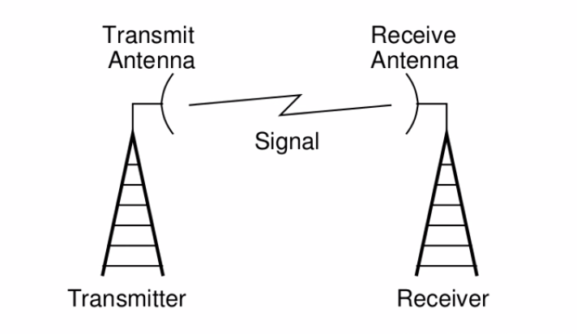
Wireless Communication Model
A simple Model of Wireless Communication System:
The transmitting Antenna converts Electrical Signals into Radio Signals
The receiving Antenna converts Radio Signals back to Electrical Signals

Slide 39
Antennas
For unguided media, transmission and reception are achieved by means of an antenna.
Electrical conductor or system of conductors used to radiate or collect electromagnetic energy
Radio frequency electrical energy from the transmitter is converted into electromagnetic energy by the antenna and radiated into the surrounding environment
Reception occurs when the electromagnetic signal intersects the antenna
In two way communication, the same antenna can be used for both transmission and reception
Notes:
An antenna can be defined as an electrical conductor or system of conductors used either for radiating electromagnetic energy or for collecting electromagnetic energy. For transmission of a signal, radio-frequency electrical energy from the transmitter is converted into electromagnetic energy by the antenna and radiated into the surrounding environment (atmosphere, space, water). For reception of a signal, electromagnetic energy impinging on the antenna is converted into radio-frequency electrical energy and fed into the receiver.
In two-way communication, the same antenna can be and often is used for both transmission and reception. This is possible because any antenna transfers energy from the surrounding environment to its input receiver terminals with the same efficiency that it transfers energy from the output transmitter terminals into the surrounding environment, assuming that the same frequency is used in both directions. Put another way, antenna characteristics are essentially the same whether an antenna is sending or receiving electromagnetic energy.

Slide 40
Radiation Pattern
Direction and propagation of a wave depends on antenna shape
Isotropic antenna
Power propagates in all directions equally (spherical pattern, ideal)
Omni-directional antenna
Power propagates in all directions on one plane (donut)
Directional antenna
Power concentrated in particular direction
Notes:
An antenna radiates power in all directions but, typically, does not perform equally well in all directions. A common way to characterize the performance of an antenna is the radiation pattern, which is a graphical representation of the radiation properties of an antenna as a function of space coordinates. The simplest pattern is produced by an idealized antenna known as the isotropic antenna. An isotropic antenna is a point in space that radiates power in all directions equally. The actual radiation pattern for the isotropic antenna is a sphere with the antenna at the center.

Slide 41
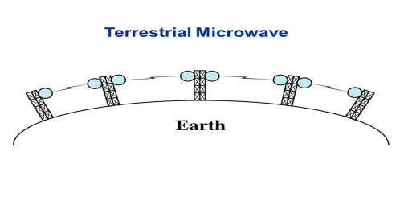
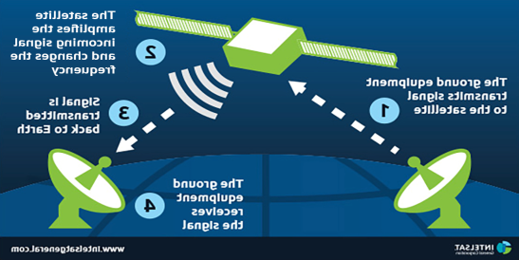
Parabolic reflective antenna
Parabolic reflective antenna - is used in terrestrial microwave and satellite applications.
The most common form is shaped like a dish and is popularly called a dish antenna or parabolic dish.
If a source of electromagnetic energy (or sound) is placed at the focus of the paraboloid, and if the paraboloid is a reflecting surface, then the wave bounces back in lines parallel to the axis of the paraboloid (Figure 4.8b).
Notes:
An important type of antenna is the parabolic reflective antenna, which is used in terrestrial microwave and satellite applications. A parabola is the locus of all points equidistant from a fixed line and a fixed point not on the line. The fixed point is called the focus and the fixed line is called the directrix (Figure 4.8a). If a parabola is revolved about its axis, the surface generated is called a paraboloid. A cross section through the paraboloid parallel to its axis forms a parabola and a cross section perpendicular to the axis forms a circle. Such surfaces are used in automobile headlights, optical and radio telescopes, and microwave antennas because of the following property: If a source of electromagnetic energy (or sound) is placed at the focus of the paraboloid, and if the paraboloid is a reflecting surface, then the wave bounces back in lines parallel to the axis of the paraboloid; Figure 4.8b shows this effect in cross section. In theory, this effect creates a parallel beam without dispersion. In practice, there is some dispersion, because the source of energy must occupy more than one point. The larger the diameter of the antenna, the more tightly directional is the beam. On reception, if incoming waves are parallel to the axis of the reflecting paraboloid, the resulting signal is concentrated at the focus.

Slide 42
Antenna Gain
A measure of the directionality of an antenna
Defined as the power output in a particular direction versus that produced by an isotropic antenna
Measured in decibels (dB)
The increased power radiated in a given direction is at the expense of other directions
Effective area of an antenna is related to the physical size of the antenna and to its shape
G_{dB} = 10 log (P₂/P₁)
G : Antenna gain,
P_{1 :} Radiated power of the directional antenna, and
P₂ : Radiated power from the reference antenna.
For example, if an antenna has a gain of 3 dB, that antenna improves upon the isotropic antenna in that direction by 3 dB, or a factor of 2.
Power output in a particular direction
VS
Power produced by an isotropic antenna.
Notes:
Antenna gain is a measure of the directionality of an antenna. Antenna gain is defined as the power output, in a particular direction, compared to that produced in any direction by a perfect omnidirectional antenna (isotropic antenna). Specifically, G_{dB} = 10 log (P₂/P₁), where G is the antenna gain, P₁ is the radiated power of the directional antenna, and P₂ is the radiated power from the reference antenna. For example, if an antenna has a gain of 3 dB, that antenna improves upon the isotropic antenna in that direction by 3 dB, or a factor of 2. The increased power radiated in a given direction is at the expense of other directions. In effect, increased power is radiated in one direction by reducing the power radiated in other directions. It is important to note that antenna gain does not refer to obtaining more output power than input power but rather to directionality. Defined as the power output in a particular direction versus that produced by an isotropic antenna
A concept related to that of antenna gain is the effective area of an antenna. The effective area of an antenna is related to the physical size of the antenna and to its shape.

Slide 43
Terrestrial Microwave
Most common type is the parabolic “dish”
Typical size is about 3 m in diameter
Antenna is fixed rigidly and focuses a narrow beam to achieve line-of-sight transmission to the receiving antenna
Usually located at substantial heights above ground level
A series of microwave relay towers is used to achieve long-distance transmission
Notes:
The most common type of microwave antenna is the parabolic
“dish.” A typical size is about 3 m in diameter. The antenna is fixed rigidly
and focuses a narrow beam to achieve line-of-sight transmission to the receiving
antenna. Microwave antennas are usually located at substantial heights above
ground level to extend the range between antennas and to be able to transmit over
intervening obstacles. To achieve long-distance transmission, a series of microwave
relay towers is used, with point-to-point microwave links strung together over the
desired distance.

Slide 44
Terrestrial Microwave Applications
Used for long haul telecommunications service as an alternative to coaxial cable or optical fiber
Used for both voice and TV transmission
Fewer repeaters but requires line-of-sight transmission
1-40 GHz frequencies, with higher frequencies having higher data rates
Main source of loss is attenuation caused mostly by distance, rainfall and interference
Notes:
The primary use for terrestrial microwave systems is in long haul telecommunications service, as an alternative to coaxial cable or optical fiber. The microwave facility requires far fewer amplifiers or repeaters than coaxial cable over the same distance, but requires line-of-sight transmission. Microwave is commonly used for both voice and television transmission.
Another increasingly common use of microwave is for short point-to-point links between buildings. This can be used for closed-circuit TV or as a data link between local area networks. Short-haul microwave can also be used for the so-called bypass application. A business can establish a microwave link to a long-distance telecommunications facility in the same city, bypassing the local telephone company.
Another important use of microwave is in cellular systems, examined in Chapter 10.
Microwave transmission covers a substantial
portion of the electromagnetic spectrum. Common frequencies used for transmission
are in the range 1 to 40 GHz. The higher the frequency used, the higher the
potential bandwidth, and therefore the higher the potential data rate.

Slide 45
Table 4.4 Typical Digital Microwave Performance
Notes:
Table 4.4 indicates bandwidth and data rate for some typical systems.
Attenuation is increased with rainfall. The effects of rainfall become especially noticeable above
10 GHz. Another source of impairment is interference. With the growing popularity
of microwave, transmission areas overlap and interference is always a danger. Thus
the assignment of frequency bands is strictly regulated.
The most common bands for long-haul telecommunications are the 4-GHz to
6-GHz bands. With increasing congestion at these frequencies, the 11-GHz band
is now coming into use. The 12-GHz band is used as a component of cable TV
systems. Microwave links are used to provide TV signals to local CATV installations;
the signals are then distributed to individual subscribers via coaxial cable.
Higher-frequency microwave is being used for short point-to-point links between
buildings; typically, the 22-GHz band is used. The higher microwave frequencies
are less useful for longer distances because of increased attenuation but are quite
adequate for shorter distances. In addition, at the higher frequencies, the antennas
are smaller and cheaper.

Slide 46
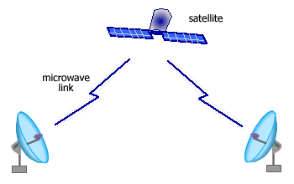
Satellite Microwave
A communication satellite is, in effect, a microwave relay station
Used to link two or more ground stations
Receives transmissions on one frequency band, amplifies or repeats the signal, and transmits it on another frequency
Frequency bands are called transponder channels
Notes:
A communication satellite is, in effect, a microwave relay station. It is used to link two or more ground-based microwave transmitter/receivers, known as earth stations, or ground stations. The satellite receives transmissions on one frequency band (uplink), amplifies or repeats the signal, and transmits it on another frequency (downlink). A single orbiting satellite will operate on a number of frequency bands, called transponder channels, or simply transponders.

Slide 47
Two common configurations for satellite communication:
The satellite is being used to provide a point-to-point link between two distant ground-based antennas.
The satellite provides communications between one ground-based transmitter and a number of ground-based receivers.
Two satellites using the same frequency band, if close enough together, interfere with each other.
To avoid this, current standards require a 4° spacing (angular displacement as measured from the earth) in the 4/6-GHz band and a 3° spacing at 12/14 GHz.
No# of possible satellites is quite limited.
Notes:
Figure 4.9 depicts in a general way two common configurations for satellite communication. In the first, the satellite is being used to provide a point-to-point link between two distant ground-based antennas.In the second, the satellite provides communications between one ground-based transmitter and a number of ground-based receivers.
For a communication satellite to function effectively, it is generally required that it remain stationary with respect to its position over the earth. Otherwise, it would not be within the line of sight of its earth stations at all times. To remain stationary, the satellite must have a period of rotation equal to the earth's period of rotation. This match occurs at a height of 35,863 km at the equator.
Two satellites using the same frequency band, if close enough together, interfere with each other. To avoid this, current standards require a 4° spacing (angular displacement as measured from the earth) in the 4/6-GHz band and a 3° spacing at 12/14 GHz. Thus the number of possible satellites is quite limited.

Slide 48
Satellite Microwave Applications
Most important applications for satellites are:
Long-distance telephone transmission
Is the optimum medium for high-usage international trunks
Private business networks
Satellite providers can divide capacity into channels and lease these channels to individual business users
Television distribution
Programs are transmitted to the satellite then broadcast down to a number of stations which then distribute the programs to individual viewers
Direct Broadcast Satellite (DBS) transmits video signals directly to the home user
Global positioning
Navstar Global Positioning System (GPS)
Notes:
Among the most important applications for satellites:
Television distribution
Long-distance telephone transmission
Private business networks
Global positioning
Because of their broadcast nature, satellites are well suited to television distribution and are being used extensively in the United States and throughout the world for this purpose. In its traditional use, a network provides programming from a central location. Programs are transmitted to the satellite and then broadcast down to a number of stations, which then distribute the programs to individual viewers. One network, the Public Broadcasting Service (PBS), distributes its television programming almost exclusively by the use of satellite channels. Other commercial networks also make substantial use of satellite, and cable television systems are receiving an ever-increasing proportion of their programming from satellites. The most recent application of satellite technology to television distribution is direct broadcast satellite (DBS), in which satellite video signals are transmitted directly to the home user. The decreasing cost and size of receiving antennas have made DBS economically feasible.
Satellite transmission is also used for point-to-point trunks between telephone exchange offices in public telephone networks. It is the optimum medium for high-usage international trunks and is competitive with terrestrial systems for many long-distance intranational links.
There are a number of business data applications for satellite. The satellite provider can divide the total capacity into a number of channels and lease these channels to individual business users. A user equipped with the antennas at a number of sites can use a satellite channel for a private network. Traditionally, such applications have been quite expensive and limited to larger organizations with high-volume requirements. A recent development is the very small aperture terminal (VSAT) system, which provides a low-cost alternative.
A final application of satellites, which has become pervasive, is worthy of
note. The Navstar Global Positioning System, or GPS for short, consists of three
segments or components:
• A constellation of satellites (currently 27) orbiting about 20,000 km above
the Earth’s surface, which transmits ranging signals on two frequencies in the
microwave part of the radio spectrum
• A control segment which maintains GPS through a system of ground monitor
stations and satellite upload facilities
• The user receivers—both civil and military

Slide 49
A recent development is the very small aperture terminal (VSAT) system, A number of subscriber stations are equipped
with low-cost VSAT antennas to provide a low-cost alternative.
Using some discipline, these stations share a satellite
transmission capacity for transmission to a hub station.
Notes:
Figure 4.10 depicts
a typical VSAT configuration. A number of subscriber stations are equipped
with low-cost VSAT antennas. Using some discipline, these stations share a satellite
transmission capacity for transmission to a hub station. The hub station can
exchange messages with each of the subscribers and can relay messages between
subscribers.
Each satellite transmits a unique digital code sequence of 1s and 0s, precisely
timed by an atomic clock, which is picked up by a GPS receiver’s antenna and
matched with the same code sequence generated inside the receiver. By lining up
or matching the signals, the receiver determines how long it takes the signals to
travel from the satellite to the receiver. These timing measurements are converted
to distances using the speed of light. Measuring distances to four or more satellites
simultaneously and knowing the exact locations of the satellites (included in the signals
transmitted by the satellites), the receiver can determine its latitude, longitude,
and height while also synchronizing its clock with the GPS time standard which also
makes the receiver a precise time piece.

Slide 50
Transmission Characteristics
The optimum frequency range for satellite transmission is 1 to 10 GHz
Below 1 GHz there is significant noise from natural sources
Above 10 GHz the signal is severely attenuated by atmospheric absorption and precipitation
Satellites use a frequency bandwidth range of
5.925 to 6.425 GHz from earth to satellite (uplink) and
range of 3.7 to 4.2 GHz from satellite to earth (downlink)
Notes:
The optimum frequency range for satellite transmission is in the range 1 to 10 GHz. Below 1 GHz, there is significant noise from natural sources, including galactic, solar, and atmospheric noise, and human-made interference from various electronic devices. Above 10 GHz, the signal is severely attenuated by atmospheric absorption and precipitation.
Most satellites providing point-to-point service today use a frequency bandwidth in the range 5.925 to 6.425 GHz for transmission from earth to satellite (uplink) and a bandwidth in the range 3.7 to 4.2 GHz for transmission from satellite to earth (downlink). This combination is referred to as the 4/6-GHz band. Note that the uplink and downlink frequencies differ. For continuous operation without interference, a satellite cannot transmit and receive on the same frequency. Thus signals received from a ground station on one frequency must be transmitted back on another.
The 4/6 GHz band is within the optimum zone of 1 to 10 GHz but has become saturated. Other frequencies in that range are unavailable because of sources of interference operating at those frequencies, usually terrestrial microwave. Therefore, the 12/14-GHz band has been developed (uplink: 14 to 14.5 GHz; downlink: 11.7 to 12.2 GHz). At this frequency band, attenuation problems must be overcome. However, smaller and cheaper earth-station receivers can be used. It is anticipated that this band will also saturate, and use is projected for the 20/30-GHz band (uplink: 27.5 to 30.0 GHz; downlink: 17.7 to 20.2 GHz). This band experiences even greater attenuation problems but will allow greater bandwidth (2500 MHz versus 500 MHz) and even smaller and cheaper receivers.
Several properties of satellite communication should be noted. First, because of the long distances involved, there is a propagation delay of about a quarter second from transmission from one earth station to reception by another earth station. This delay is noticeable in ordinary telephone conversations. It also introduces problems in the areas of error control and flow control, which we discuss in later chapters. Second, satellite microwave is inherently a broadcast facility. Many stations can transmit to the satellite, and a transmission from a satellite can be received by many stations.

Slide 51
Broadcast Radio
Broadcast radio is omnidirectional and microwave is directional
Radiois the term used to encompass frequencies in the range of 3kHz to 300GHz
Broadcast radio (30MHz - 1GHz) covers:
FM radio and UHF and VHF television band
Data networking applications
Limited to line of sight
Suffers from multipath interference
Reflections from land, water, man-made objects
Notes:
The principal difference between broadcast radio and microwave is that the former is omnidirectional and the latter is directional. Thus broadcast radio does not require dish-shaped antennas, and the antennas need not be rigidly mounted to a precise alignment.
Radio is a general term used to encompass frequencies in the range of 3 kHz to 300 GHz. We are using the informal term broadcast radio to cover the VHF and part of the UHF band: 30 MHz to 1 GHz. This range covers FM radio and UHF and VHF television. This range is also used for a number of data networking applications.
The range 30 MHz to 1 GHz is an effective one for broadcast communications. Unlike the case for lower-frequency electromagnetic waves, the ionosphere is transparent to radio waves above 30 MHz. Thus transmission is limited to the line of sight, and distant transmitters will not interfere with each other due to reflection from the atmosphere. Unlike the higher frequencies of the microwave region, broadcast radio waves are less sensitive to attenuation from rainfall.

Slide 52
Infrared
Achieved using transceivers that modulate noncoherent infrared light
Transceivers must be within line of sight of each other directly or via reflection
Does not penetrate walls
No licensing is required
No frequency allocation issues
Notes:
Infrared communications is achieved using transmitters/receivers (transceivers) that modulate noncoherent infrared light. Transceivers must be within the line of sight of each other either directly or via reflection from a light-colored surface such as the ceiling of a room.
One important difference between infrared and microwave transmission is that the former does not penetrate walls. Thus the security and interference problems encountered in microwave systems are not present. Furthermore, there is no frequency allocation issue with infrared, because no licensing is required.

Slide 53
Ground wave propagation follows the contour of the earth and can propagate distances well over the visual horizon
This effect is found in frequencies up to about 2MHz
The best known example of ground wave communication
is AM radio
Notes:
Ground wave propagation (Figure 4.11a) more or less follows the contour of the earth and can propagate considerable distances, well over the visual horizon. This effect is found in frequencies up to about 2 MHz. Several factors account for the tendency of electromagnetic wave in this frequency band to follow the earth's curvature. One factor is that the electromagnetic wave induces a current in the earth's surface, the result of which is to slow the wavefront near the earth, causing the wavefront to tilt downward and hence follow the earth's curvature. Another factor is diffraction, which is a phenomenon having to do with the behavior of electromagnetic waves in the presence of obstacles. Electromagnetic waves in this frequency range are scattered by the atmosphere in such a way that they do not penetrate the upper atmosphere.
The best-known example of ground wave communication is AM radio.

Slide 54
Sky wave propagation is used for amateur radio and international broadcasts such as BBC and Voice of America
A signal from an earth based antenna is reflected from the ionized layer of the upper atmosphere back down to earth
Sky wave signals can travel through a number of hops, bouncing back and forth between the ionosphere and the earth’s surface
Notes:
Sky wave propagation is used for amateur radio and international broadcasts such as BBC and Voice of America. With sky wave propagation, a signal from an earth-based antenna is reflected from the ionized layer of the upper atmosphere (ionosphere) back down to earth. Although it appears the wave is reflected from the ionosphere as if the ionosphere were a hard reflecting surface, the effect is in fact caused by refraction. Refraction is described subsequently.
A sky wave signal can travel through a number of hops, bouncing back and forth between the ionosphere and the earth's surface (Figure 4.11b). With this propagation mode, a signal can be picked up thousands of kilometers from the transmitter.

Slide 55
Ground and sky wave propagation modes do not operate above 30MHz - - communication must be by line of sight
Notes:
Above 30 MHz, neither ground wave nor sky wave propagation modes operate, and communication must be by line of sight( Figure 4.11c). For satellite communication, a signal above 30 MHz is not reflected by the ionosphere and therefore a signal can be transmitted between an earth station and a satellite overhead that is not beyond the horizon. For ground-based communication, the transmitting and receiving antennas must be within an effective line of sight of each other. The term effective is used because microwaves are bent or refracted by the atmosphere. The amount and even the direction of the bend depend on conditions, but generally microwaves are bent with the curvature of the earth and will therefore propagate farther than the optical line of sight.

Slide 56
Line-of-Sight Transmission
Free space loss
Loss of signal with distance
Atmospheric Absorption
From water vapor and oxygen absorption
Multipath
Multiple interfering signals from reflections
Refraction
Bending signal away from receiver
Some impairments specific to wireless line-of-sight transmission.
Notes:
Section 3.3 discusses various transmission impairments common to both guided and wireless transmission. In this section, we extend the discussion to examine some impairments specific to wireless line-of-sight transmission.
For any type of wireless communication the signal disperses with distance. Therefore, an antenna with a fixed area receives less signal power the farther it is from the transmitting antenna. For satellite communication this is the primary mode of signal loss. Even if no other sources of attenuation or impairment are assumed, a transmitted signal attenuates over distance because the signal is being spread over a larger and larger area. This form of attenuation is known as free space loss, which can be expressed in terms of the ratio of the radiated power P_{t} to the power P_{r} received by the antenna or, in decibels, by taking 10 times the log of that ratio.
An additional loss between the transmitting and receiving antennas is atmospheric
absorption. Water vapor and oxygen contribute most to attenuation. A
peak attenuation occurs in the vicinity of 22 GHz due to water vapor. At frequencies
below 15 GHz, the attenuation is less. The presence of oxygen results in
an absorption peak in the vicinity of 60 GHz but contributes less at frequencies
below 30 GHz. Rain and fog (suspended water droplets) cause scattering of radio
waves that results in attenuation. In this context, the term scattering refers to the
production of waves of changed direction or frequency when radio waves encounter
matter. This can be a major cause of signal loss. Thus, in areas of significant
precipitation, either path lengths have to be kept short or lower-frequency bands
should be used.
For wireless facilities where there is a relatively free choice of where antennas are to be located, they can be placed so that if there are no nearby interfering obstacles, there is a direct line-of-sight path from transmitter to receiver. This is generally the case for many satellite facilities and for point-to-point microwave. In other cases, such as mobile telephony, there are obstacles in abundance. The signal can be reflected by such obstacles so that multiple copies of the signal with varying delays can be received. In fact, in extreme cases, there may be no direct signal. Depending on the differences in the path lengths of the direct and reflected waves, the composite signal can be either larger or smaller than the direct signal. Reinforcement and cancellation of the signal resulting from the signal following multiple paths can be controlled for communication between fixed, well-sited antennas, and between satellites and fixed ground stations. One exception is when the path goes across water, where the wind keeps the reflective surface of the water in motion. For mobile telephony and communication to antennas that are not well sited, multipath considerations can be paramount.
Radio waves are refracted (or bent) when they propagate through the atmosphere.
The refraction is caused by changes in the speed of the signal with altitude or by
other spatial changes in the atmospheric conditions. Normally, the speed of the
signal increases with altitude, causing radio waves to bend downward. However, on
occasion, weather conditions may lead to variations in speed with height that differ
significantly from the typical variations. This may result in a situation in which only
a fraction or no part of the line-of-sight wave reaches the receiving antenna.

Slide 57
Types of multipath interference:
Terrestrial
Fixed microwave
In addition to the direct line of sight, the signal may follow a curved path through the atmosphere due to refraction and the signal may also reflect from the ground.
Mobile communications
Structures and topographic features provide reflection surfaces.
Notes:
Figure 4.14 illustrates in general terms the types of multipath interference typical in terrestrial, fixed microwave and in mobile communications. For fixed microwave, in addition to the direct line of sight, the signal may follow a curved path through the atmosphere due to refraction and the signal may also reflect from the ground. For mobile communications, structures and topographic features provide reflection surfaces.

Slide 58
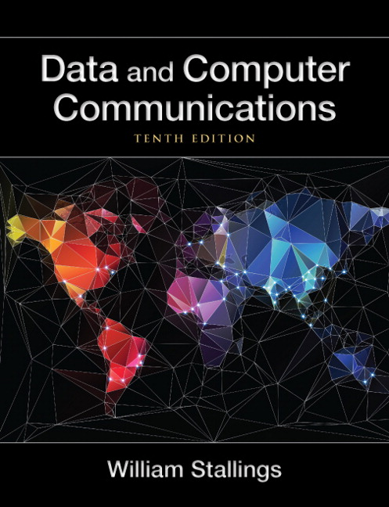
Summary
Guided transmission media
Twisted pair
Coaxial cable
Optical fiber
Wireless transmission
Antennas
Terrestrial microwave
Satellite microwave
Broadcast radio
Infrared
Wireless propagation
Ground wave propagation
Sky wave propagation
Line-of-sight propagation
Line-of-sight transmission
Free space loss
Atmospheric absorption
Multipath
Refraction
Notes:
Chapter 4summary.

Slide 60
Thank You

